Slide 1
Medium-Sized Switched Network Construction
Routing Between VLANs

Slide 2
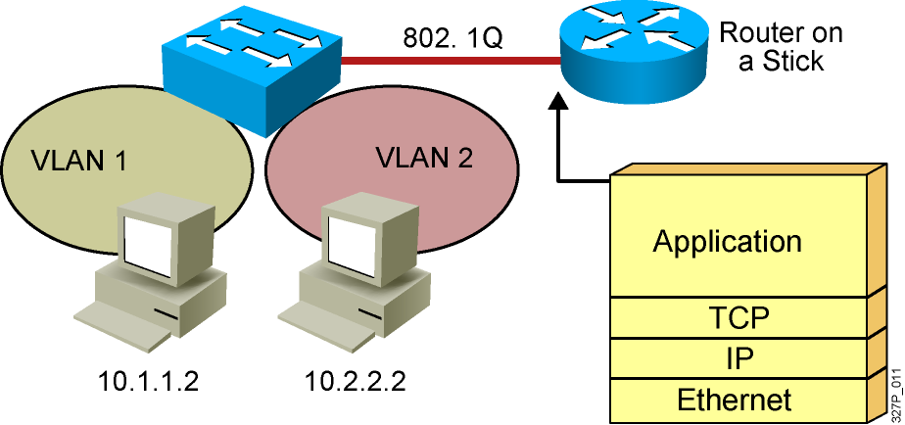
VLAN-to-VLAN Overview
Network layer devices combine multiple broadcast domains.
Notes:
Purpose: This figure shows a router on a stick being used to interconnect VLANs.
Emphasize: The VLANs are on different networks. Without a network layer device they could not communicate.
Review the protocols operating at each of the OSI layers.

Slide 3
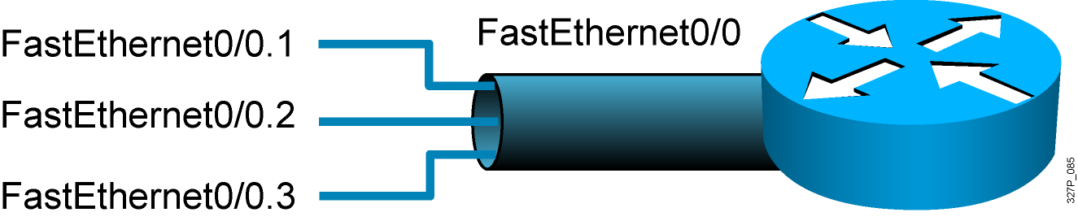
Dividing a Physical Interface into Subinterfaces
Physical interfaces can be divided into multiple subinterfaces.
Notes:
Purpose: This figure shows a subinterface example. Subinterfaces will be covered later in this course.
Emphasize: At this point, it is important for students to understand that if they want to connect multiple VLANs, they need a separate connection for each VLAN. This can be accomplished by establishing a physical connection for each VLAN that will interconnect with other VLANs, or by splitting a trunk into multiple, logical subinterfaces.

Slide 4
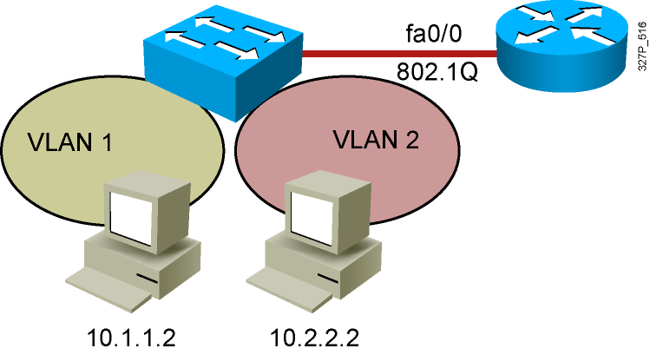
Routing Between VLANs with 802.1Q Trunks
interface fastethernet 0/0
ip address 10.1.1.1 255.255.255.0
interface fastethernet 0/0.2
ip address 10.2.2.1 255.255.255.0
encapsulation dot1q 2

Slide 5
Summary
  Inter-VLAN routing using a router on a stick utilizes an external router to pass traffic between VLANs.
  A router on a stick is configured with a subinterface for each VLAN and 802.1Q trunk encapsulation.

